Slide 1
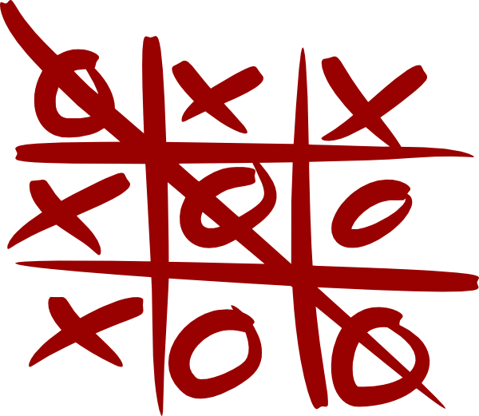
COMP 472 Experiments and Analysis for Mini Project 2
By Karim Ramy Boshra Botros (40179768), Ryan Amstutz (40170386) and Iris Radu (40179149)

Slide 2
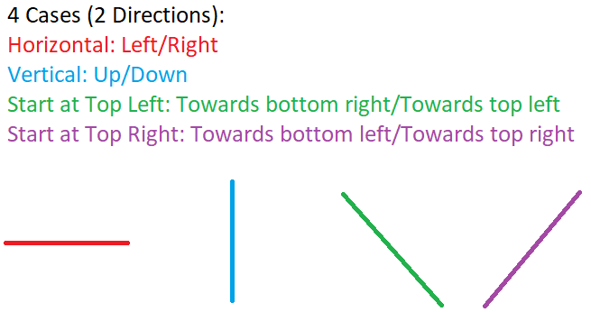
E1
Algorithm:
Score = starts at 0
Symbol = current player’s symbol (X or O)
For each case:
Calculate score: for each direction:
Until snake of equal symbols is broken by block/pening symbol
Pseudocode:
Iterator “i” = 0
While within board’s bounds and haven’t met # or opposing symbol:
+1 to snakeCount when meeting a “.” or a similar symbol
i += 1
If snakeCount adds up to s (can make a snake on this line)
Pseudocode for horizontal/vertical case:
if snakeCount >= self.s:
score += snakeCount * 4
else:
score += snakeCount * 2
Heuristic favors diagonal cases
Pseudocode for other diagonal cases:
if snakeCount >= self.s:
score += snakeCount * 20
else:
score += snakeCount * 8
Return score
Simple, but efficient

Slide 3
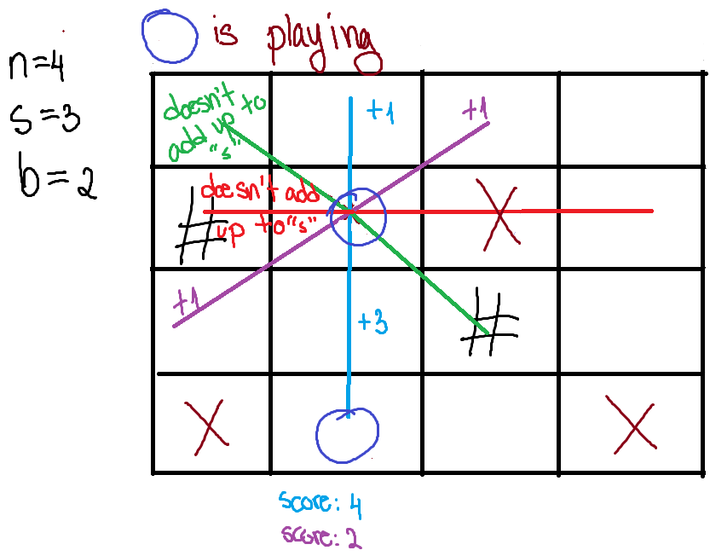
E2
Algorithm:
Score = starts at 0
Symbol = current player’s symbol (X or O)
For each case:
Check prediction: the total space free (in both directions) adds up to at least “s” (number of symbols is a row to win)
Pseudocode:
Iterator “i” = 0
Number of spaces free in both direction “snakeCount” = 0
For each direction (2):
While next space is free or similar “symbol” and within board bounds:
+1 to i, +1 to snakeCount
If the prediction passes THEN
Pseudocode:
If snakeCount >= “s”
Calculate score for each direction and added (substract during min’s or X’s turn) to score variable:
Until snake of equal symbols is broken by block/opposing symbol
Pseudocode:
Iterator “i” = 0
While within board’s bounds and haven’t met # or opposing symbol:
Depending on player’s turn +/- 1 to score when meeting a “.”
+/- “n” - “i” to score when meeting a similar symbol
i += 1
Return score
More complex, but slower

Slide 4
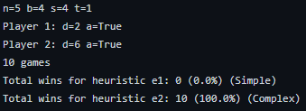
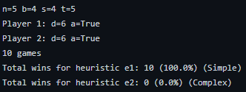
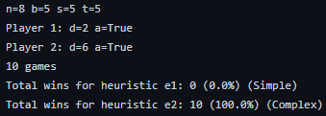
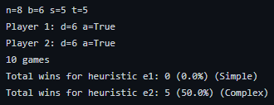
Analysis of data: Impact of E1 & E2
Overall, players who use E2 have a higher chance to win on average compared to players who use E1. Though the computation takes quite a while on larger spaces (when n >= 6), the player using E2 seems to win the match the most.
The only instance where E1 is better than E2 is for the game with n=5, b=4, s=4, t=5, d1=6 and d2=6. This might be caused by the randomness of the blocs’ placements or due to E2 never reaching a golden state (a state better than all the others).

Slide 5
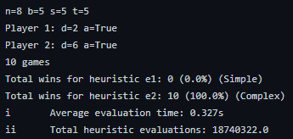
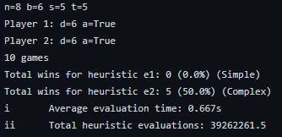
Analysis of data: Impact of Depth
As the depth of either players increase, the average evaluation time increases. Furthermore, the total heuristic evaluations increase due to the numerous states that need to be visited.
In the first example, Player 1 has a depth of 2 while Player 2 has a depth of 6. Such a big gap allows Player 2 to win easily (100.0% of the time). In the second example, Player 1 and Player 2 have the same depths, which decreases Player’s 2 win rate by 50%.
Increasing the depth will certainly increase the average evaluation time, but more states will be evaluated and the two players have a higher chance to come to a tie (since Player 1 is minimizing and Player 2 is maximizing).

Slide 6
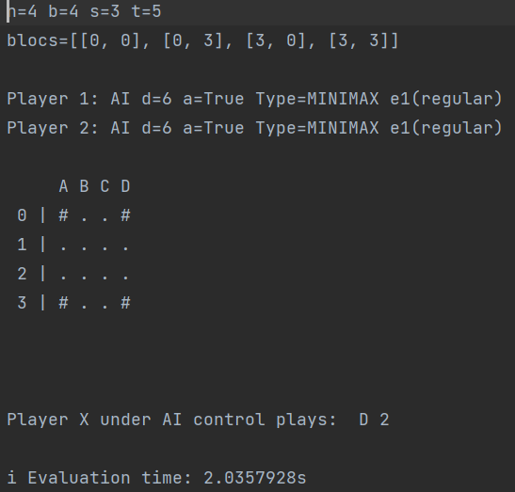
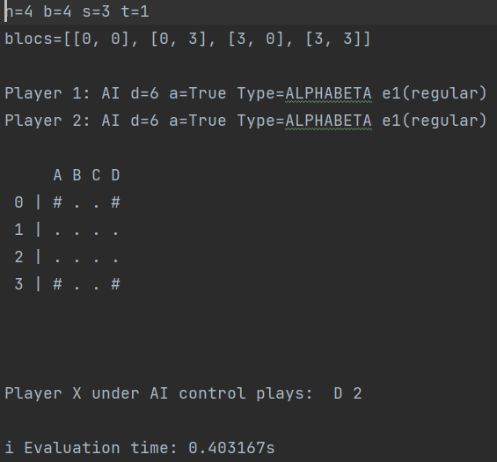
Analysis of data: Impact of Alpha-Beta
The usage of the Alpha-Beta algorithm considerably lowers the average evaluation time. The same game running on Minimax took 2.035 seconds to evaluate the first move, while the game running on Alpha-Beta took 0.403 seconds.
The number of states explored is also greatly cut because of the pruning that occurs in the Alpha-Beta algorithm.

Slide 7
Exit(0)

